Slide 1




NEXT GEN EMPLOYABILITY PROGRAM
Creating a future-ready workforce
Team Members
College Name
Student Name : Preetha K
Student ID :au960221104085
Arunachala college of Engineering for Women

Slide 2

CAPSTONE PROJECT SHOWCASE
Project Title
Car Rentals Application with Django Framework
Abstract | Problem Statement | Project Overview | Proposed Solution | Technology Used | Modelling & Results | Conclusion

Slide 3
Abstract
This project proposes the development of a user-friendly car rental website using Django. The system aims to streamline the rental process for both customers and administrators, featuring key functionalities such as user authentication, real-time availability tracking, dynamic pricing, and secure payment integration. Administrators will have access to a centralized dashboard for inventory management and reporting, while customers can easily browse vehicles, make reservations, and track bookings. The system prioritizes scalability, security, and extensibility, promising to meet the evolving needs of the car rental industry.
Source :

Slide 4
Problem Statement
The car rental industry faces inefficiencies due to manual processes and outdated systems, leading to challenges in managing bookings and providing a seamless experience for customers. There is a need for a modern car rental management system using Django to automate processes, improve user experience, and enhance operational efficiency for both customers and administrators.
Source :

Slide 5
Project Overview
The project involves the development of a dynamic car rental management system using Django, a high-level Python web framework.
Key Features:
User Authentication: Secure login and registration system for both customers and administrators.
Vehicle Inventory Management: Comprehensive database for storing vehicle details, including availability, pricing, and specifications.
Booking System: Intuitive interface for customers to search for available vehicles, select rental dates, and make reservations.
Real-time Availability Tracking: System updates availability status dynamically to prevent overbooking and ensure accurate information for customers.
Dynamic Pricing: Pricing calculation based on factors such as vehicle type, duration, and location.
Source :

Slide 6
Proposed Solution
.
The proposed solution involves building a Django-based car rental management system. It will provide users with an intuitive interface for booking vehicles and administrators with tools for inventory management and reporting. Key features include user authentication, real-time availability tracking, dynamic pricing, payment integration, and a responsive design. The solution aims to streamline rental processes, enhance user experience, and ensure scalability and security.
Django Framework: Utilize Django, a high-level Python web framework, for rapid development, robust security features, and scalability.
Model for Vehicle Inventory: Create a Django model to manage vehicle inventory, including attributes such as make, model, year, availability status, and rental price.
Reservation System: Implement a reservation system using Django's built-in ORM (Object-Relational Mapping) to manage bookings, including date/time selection, pickup/drop-off locations, and customer details.
Source :

Slide 7
User Authentication: Utilize Django's authentication system to allow users to create accounts, log in, and manage bookings, ensuring data security and user privacy.
Admin Panel: Leverage Django's admin interface to provide an intuitive backend for administrators to manage inventory, view reservations, and access analytics.
Frontend Design: Utilize Django's template system along with HTML, CSS, and JavaScript to create a responsive and user-friendly frontend interface for browsing vehicles, making reservations, and viewing account information.
Integration with Payment Gateways: Integrate popular payment gateways such as Stripe or PayPal using Django packages or APIs to facilitate secure online payments for reservations.
Search and Filter Functionality: Implement search and filter functionalities using Django's query set API to allow users to easily find vehicles based on criteria such as location, date, vehicle type, and price.
Feedback and Reviews: Integrate a feedback and review system where users can leave ratings and comments for rented vehicles, enhancing trust and providing valuable feedback for improvement.
Source :

Slide 8
Booking management
Car management
Payment management
Car rental
Customer management
System user management
Login management
Source :

Slide 9


Technology Used
Front-end
Back-end
Source :

Slide 10
Modelling & Results
Modeling:
The modeling phase involves designing the database schema and creating Django models to represent entities such as users, vehicles, bookings, and transactions. Relationships between entities are defined, and fields are specified for data storage. For example:
User model includes fields for username, email, and password.
Vehicle model includes fields for make, model, year, price, and availability.
Booking model includes fields for user, vehicle, start date, end date, and status.
Results:
After development, the system provides a user-friendly interface for customers to browse vehicles, make reservations, and manage bookings. Administrators can efficiently manage inventory, track bookings, and generate reports. Key features such as user authentication, real-time availability tracking, dynamic pricing, and payment integration are implemented successfully.
Source :

Slide 11
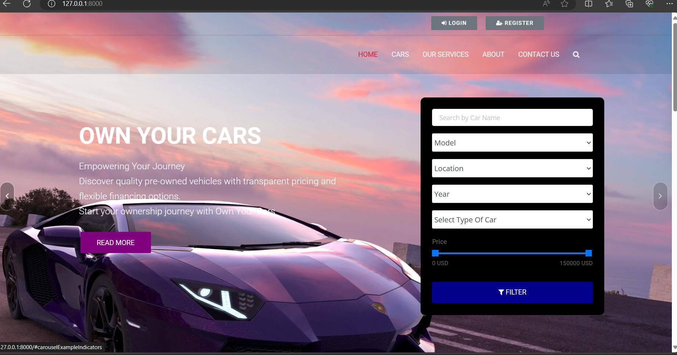
Homepage

Slide 12
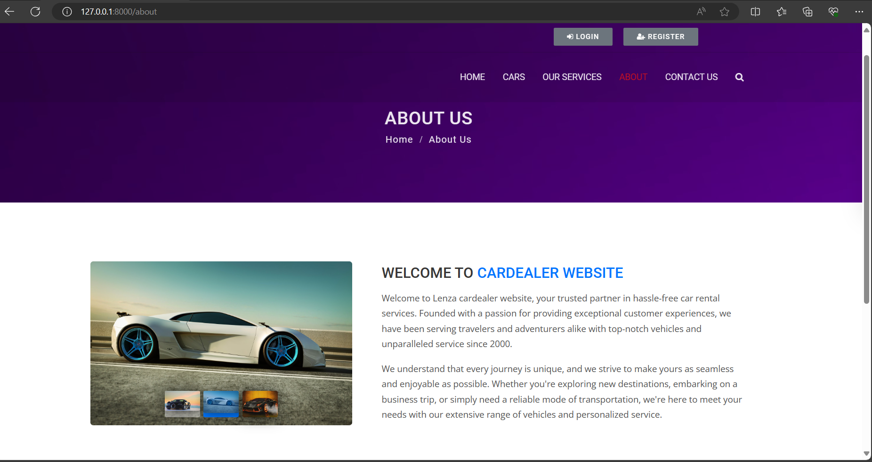
About-Us-Page

Slide 13
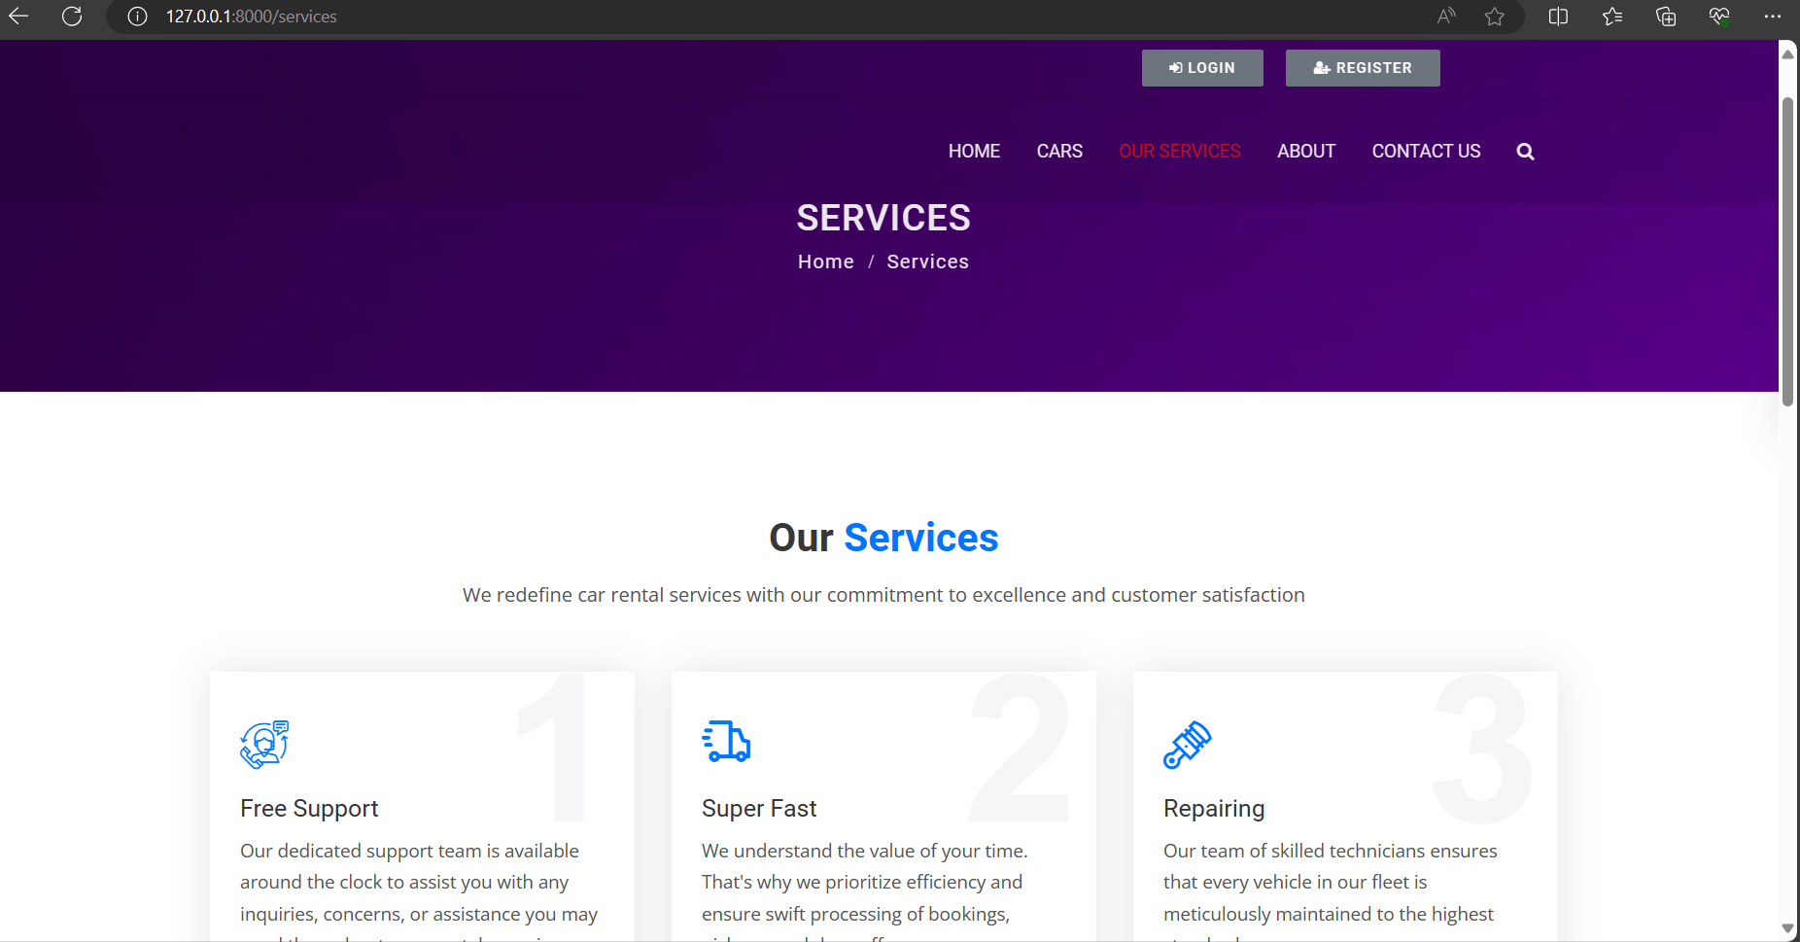
Service-Page

Slide 14
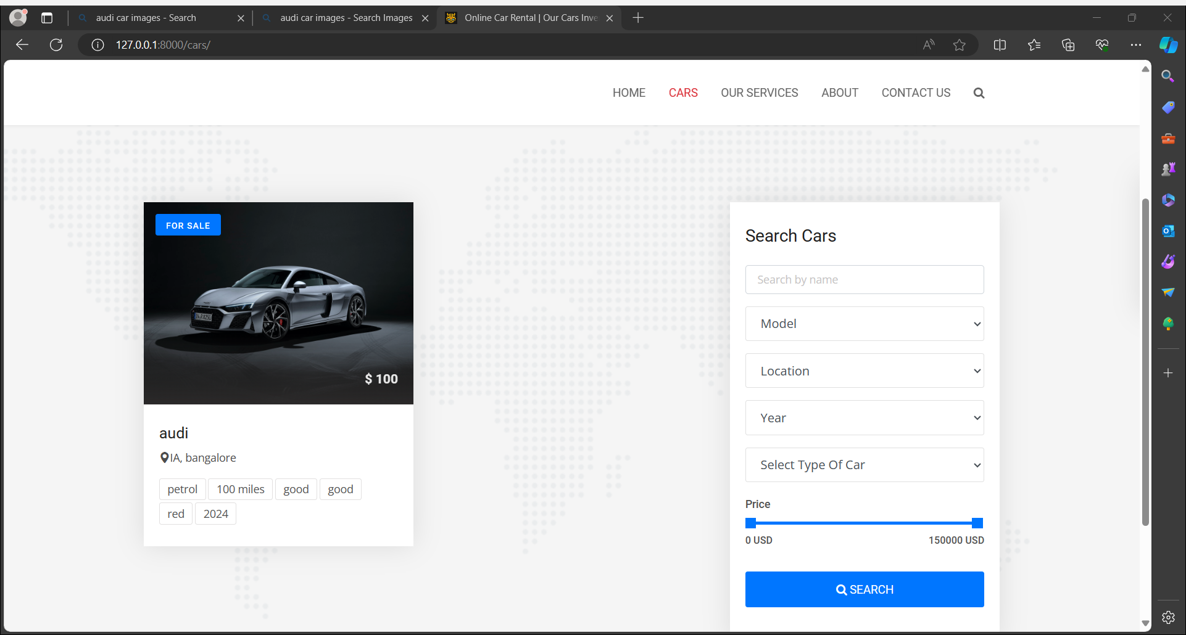
Cars-Page

Slide 15
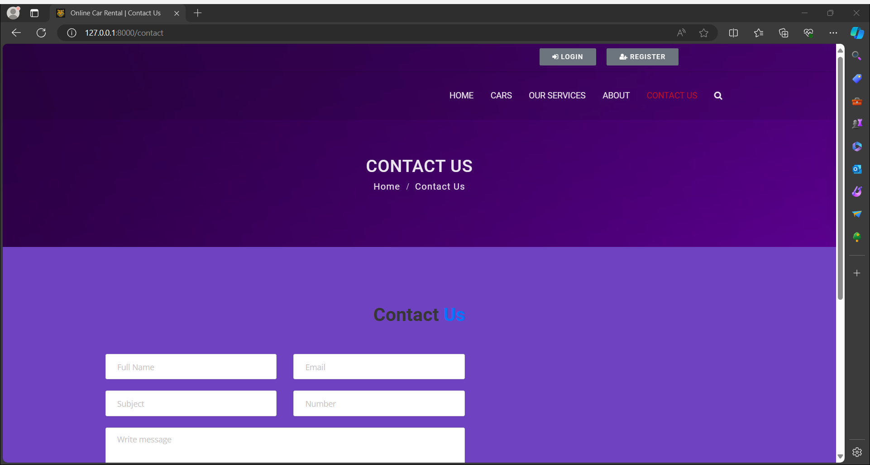
Contact Us-Page

Slide 16
Future Enhancements:
Improved User Experience: Intuitive interface with filtering options and personalized recommendations.
Advanced Analytics: Track user behavior for pricing optimization and marketing strategies.
IoT Integration: Monitor vehicle health and usage data for better fleet management.
Mobile App: Convenient access for booking and management on smartphones.
AI Features: Dynamic pricing, fraud detection, and predictive maintenance.
Diverse Payment Options: Digital wallets, cryptocurrencies, and installment plans.
Localization: Multi-language and multi-currency support for global users.
External Service Integration: GPS navigation, roadside assistance, and insurance providers.
Sustainability Initiatives: Eco-friendly options and carbon offsetting programs.
Voice Recognition and Chatbots: Hands-free interaction and instant assistance for users.

Slide 17
Conclusion
In conclusion, the Django-based car rental management system offers enhanced efficiency and user experience for both customers and administrators. Key features like real-time availability tracking and dynamic pricing streamline operations, while future enhancements such as IoT integration and AI-powered features promise further innovation. With a focus on scalability and security, the system is poised to redefine the car rental industry and provide sustainable solutions for future growth.
Source :

Slide 18
Thank You!
Notes:
Thank You !!

